Slide 1
Root and single user mode
A Sharpe Curriculum

Slide 2
Securing Root review
Entered into single user mode by modifying GRUB
Remounted root to read-write
Recalculated a new password hash based on your brand new choice of password and stored in /etc/shadow

Slide 3
Securing Root review
-Lastly we disabled root
The focus we will take on is what exactly is init

Slide 4

What is the first process on your system?
The first process, PID (Process ID) is init
Every process after that is a child process of init.

Slide 5
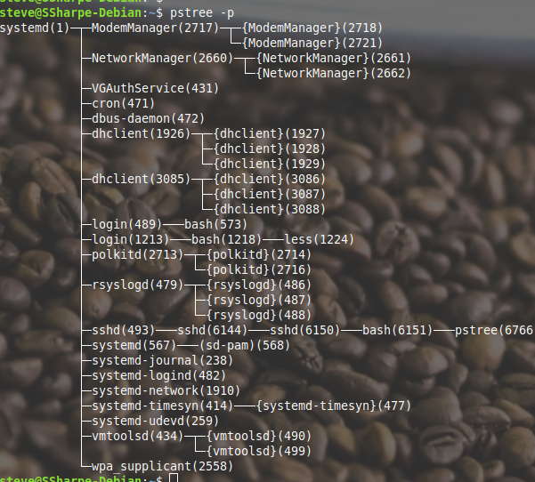
Look at pstree
To install pstree sudo apt install psmisc
Note the number
In round brackets
Is the PID

Slide 6
Why does ps say init but pstree says systemd?
Hey another symbolic link!

Slide 7

ps vs lsof vs pstree
ps gave the name of the file that was called upon, which was truly the symlink /usr/sbin/init
pstree behaved similarly to lsof and called the actual opened file in memory.

Slide 8
Eureka!
So init is a symlink for legacy purposes, but truthfully the system control isn’t init it’s actually systemd.
This isn’t a history class but there are MANY alternatives than just systemd for init.

Slide 9
Great. What does systemd do?
It controls nearly every aspect of your Linux system.
It spawns a getty (more on this later)
It controls daemons (known as services in Windows)
And a ton of other flags under /etc/sysctl.conf
and a lot more.

Slide 10
GRUB edits
So we removed ro quiet, then replaced with single init=/bin/bash
So the single is saying runlevel 1
Instead of the first process being init, we’ve said the first process we want to be the bash shell

Slide 11
Shhh. Quiet!
By default all distributions whether server, workstation or desktop seem to include quiet for the most puzzling reasons. It hides the messages from systemd. Remember in lab 2 you removed ro quiet and replaced with additional information to go into runlevel 1. We’re going to focus on quiet

Slide 12
Quiet frankly useless on a server
It’s designed to hide the output of systemd to not confuse end users using Linux as a desktop. However if something fails during startup and you’re sitting in front of the computer it’s nice to see something failed.

Slide 13


No more quiet
Using both sudo and your favourite editor remove quiet in double quotes.
Write changes ->

Slide 14
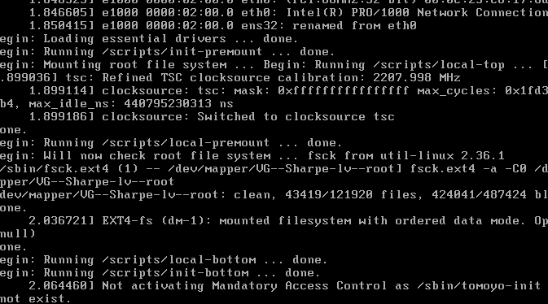
Hurray, kernel messages
When you reboot you’ll know see messages from both the kernel & systemd

Slide 15

Terminals
Getty or agetty creates physical consoles

Slide 16

Create two superhero accounts
Your time to shine here, Batman, Professor X you name it. We just need two new users.
I just made Batman and Robin for this example

Slide 17
Getty spawns based on sockets
The terminal doesn’t actually exist till you try to access it. Not existing till you access is true of a lot of things in Linux, more examples later in this course.
Two ways to access your tty (next slide)

Slide 18
Alt+F-key
This key combo can run amok because a lot of laptops default to using function keys such as F1, F2, etc to mute, volume control, brightness.
The current tty you’re on right now is tty1 which is alt+f1. Fully customizable but Debian stops at f6.

Slide 19
Alt + left or right arrow keys
You can also cycle through the terminals using alt + left or right arrow keys.
What if I have a graphical user interface such as KDE or GNOME??
Then your only option is ctrl+alt+f-key then once you’ve dropped to console then you can cycle through the consoles again with arrow keys.

Slide 20
Spawn two more ttys
Using your new users, in my case Batman & Robin.
tty1 - Your first name
tty2 - First superhero
tty3 - Second superhero

Slide 21
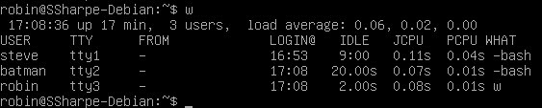
Three physical terminals in use
You’ve now used up 3 ttys

Slide 22
Pseudoterminal
You’ve seen a physical interface which is a tty, but that is if you have physical access and in our case we have physical keyboard and VGA (monitor) access. If we have a remote system are options are telnet (what’s wrong with telnet?) or ssh.

Slide 23
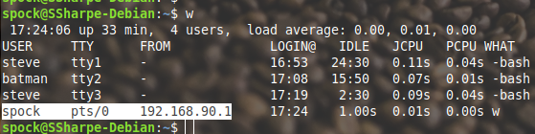
Pseudoterminal
Note: a pseudoterminal abbreviated pts (or vty in Cisco). In certain cases you’ll see Linux use pty

